Slide 1
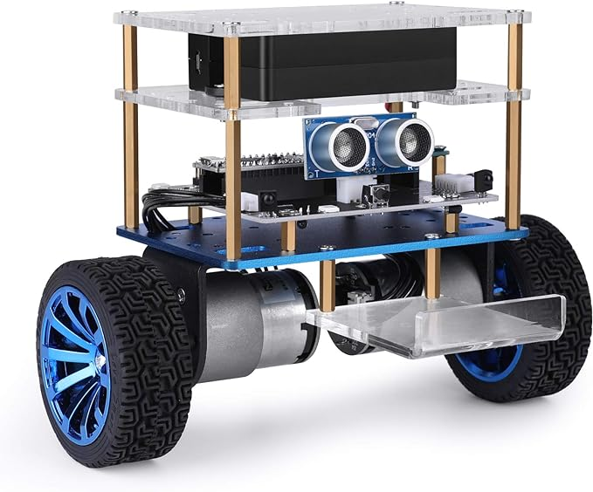
Self balancing robot Software prototype by Team 12 akash patil & vidhya palaniappan
30th April 2024

Slide 2
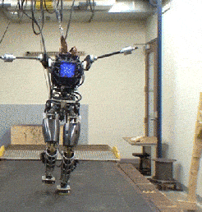
What’s a self balancing robot?
A robot/vehicle that often runs on two wheels/limbs. It maintains an upright balance while doing so.
It will also absorb any jerks imparted to it and come back to its neutral upright position.

Slide 3
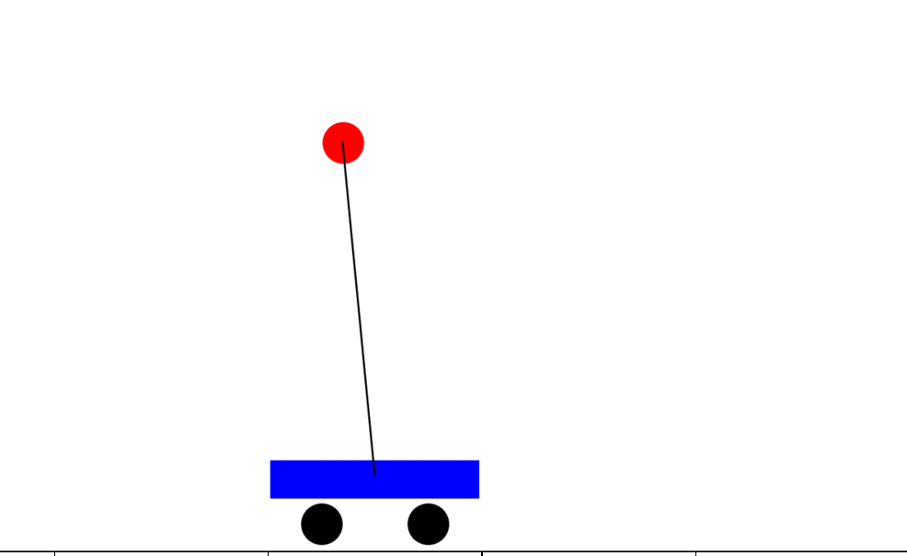
How does it do that?
It works with a combination of sensors and actuator. It takes its angle and tilt information from the an IMU and commands the motor based on this data to move in that direction, to neutralize that change.
It uses an algorithm to determine the commands that is needs to provide to the motor, often a PID controller.
This a real time application of the classic dynamics and control theory problem called the Inverted Pendulum.

Slide 4
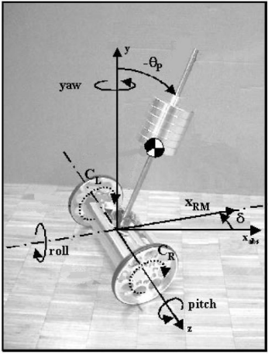
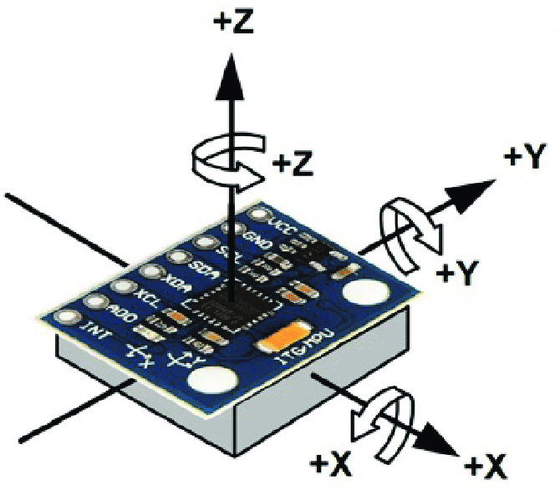
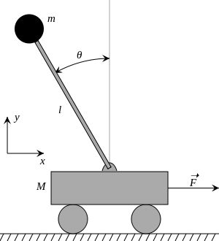
Control theory to Real- time translation
Inverted Pendulum on a moving cart
IMU with 3 axes

Slide 5
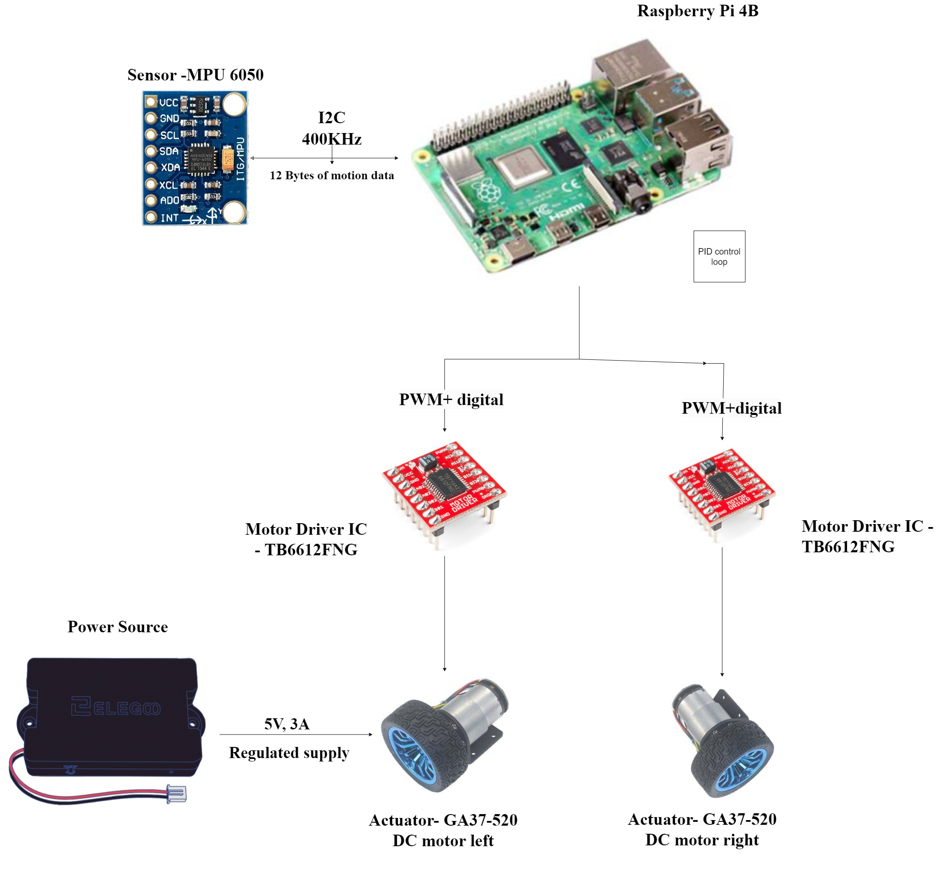
System Block diagram

Slide 6
Capability requirements
Steady state: when all support is taken away, the robot stands on its own. Angular velocity along y axis = 0 rad/s and x axis at 0 degrees.
Time to stabilize when a jerk is provided, the system restores balance in under 3 seconds.
Overshoot: the system will not oscillate along its steady state unless a jerk is impacted.
Payload: should be able to carry a load of 100 grams.
Tilt: can stabilize itself with jerks resulting in tilts of up to 5.5 degrees.
Stretch Goal
Move in the direction of user input, at 2inches/s

Slide 7
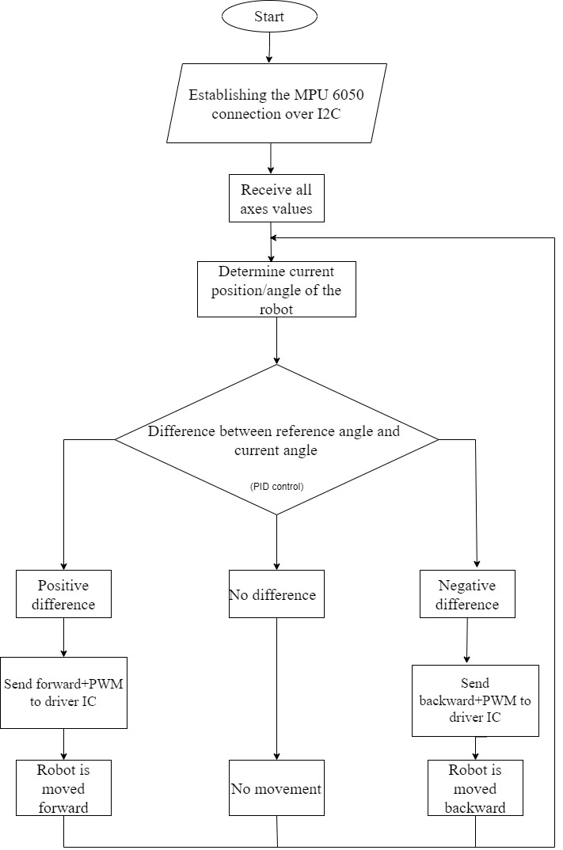
Control Flow diagram

Slide 8
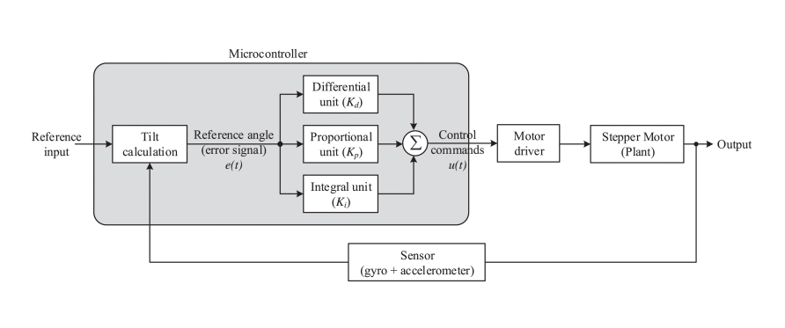
PID Controller algorithm

Slide 9
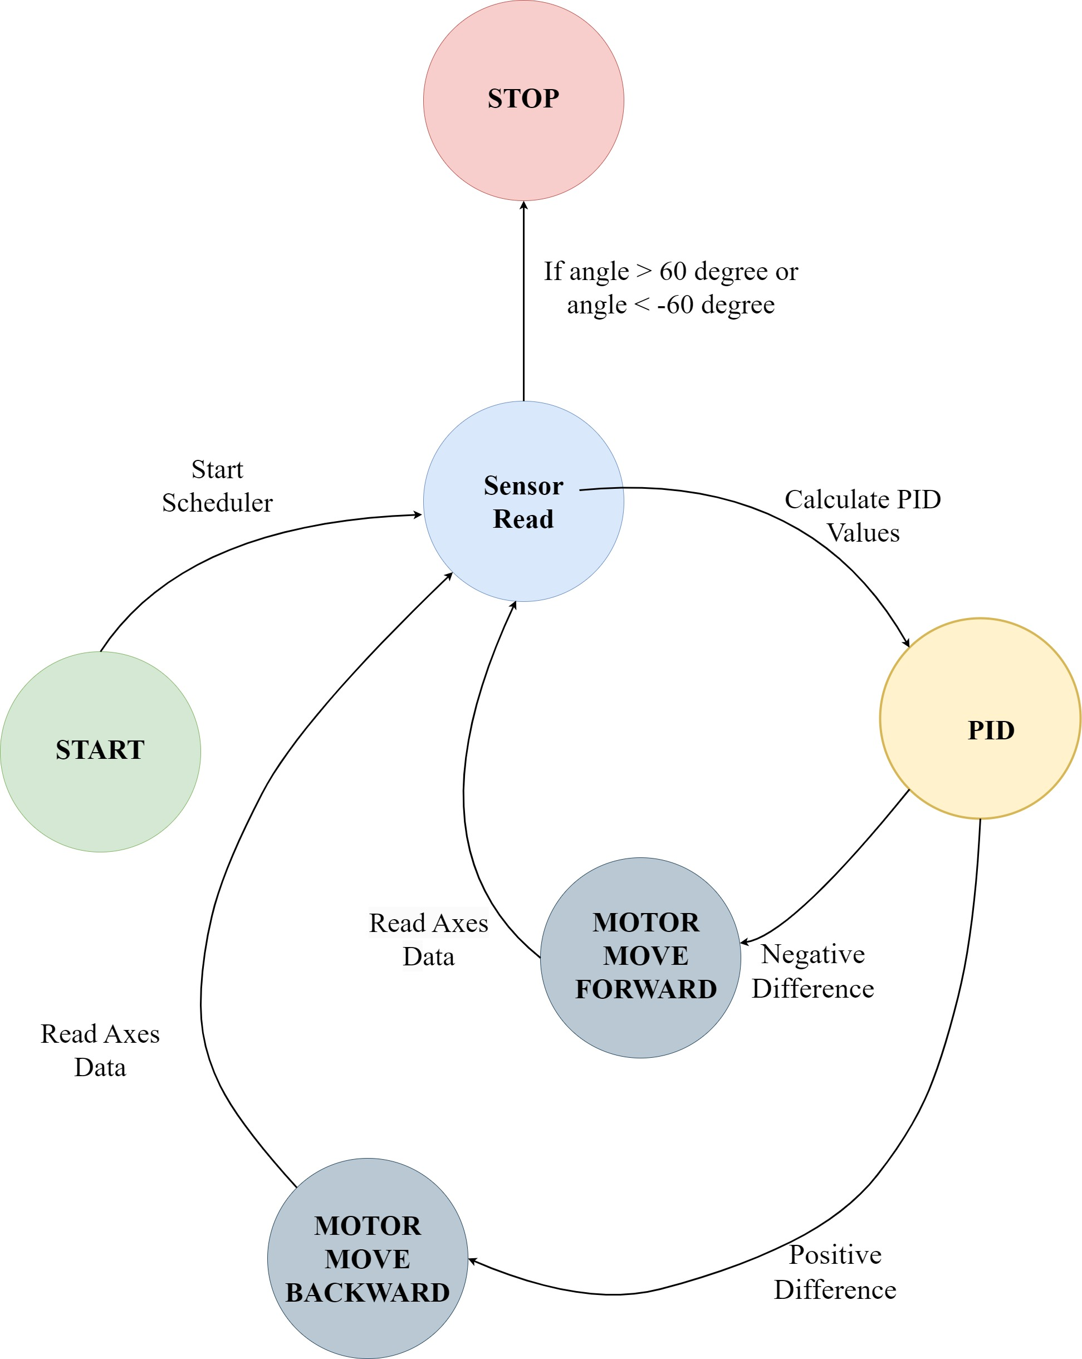
State Machine

Slide 10
Services and description
Service 1: Sensor read
Service 2: PID algorithm
Service 3: Motor control
This service initiates the I2C read from the MPU6050.
16 bits of data per axis per sensor.
Reads at 400Kbps
3 axes(XL) + 3 axes (gyro)
Stores it in a global variable.
Releases S2.
This service first calculates tilt angle and angular acceleration from the data acquired in S1.
Then error is calculated based on steady state.
This error is then processed through the PID loop.
PID outputs motor feedback and stores its speed.
Releases S3.
Reads the motor control value generated by previous service.
Offsets this speed with the inherent motor offsets for each channel separately.
Generates and transmits PWM for speed and digital output for motor direction.
Locks all three services.

Slide 11
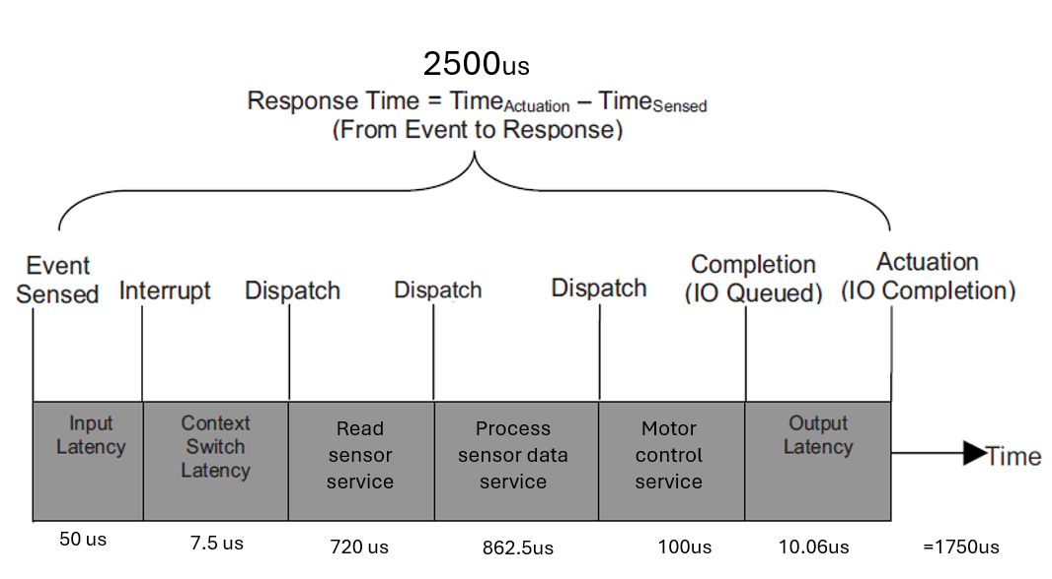
SERVICE TIMELINE

Slide 12
How did we arrive at those numbers?
According to this paper, a sampling rate of 400 times per second should be enough to maintain balance. Giving us a period of 1s/400 = 2.5ms = 2500us. Each measurement of angle, PID error calculation and motor control should be completed within this time frame.
The input latency between the MPU 6050 INT pin to the Pi takes about 50us.
I2C reads 12 bytes of data at 400Kbps, needing a minimum of 720us for S1.
The motor control service generates the PWM & digital outputs. With PWM frequency at 10KHz, the time required for each pulse is 1s/10k=100us. This is C for our S3.
From the datasheet, the motor takes maximum of 10us to respond to the input. The rise time and setup and hold time are about 25ns and 41ns, respectively. This adds to the output latency.
The Context switch in an ARM based Linux system takes on an average 2.5us. With three services, it adds up to 7.5 us for three services.
That leaves us about 862.5 us for the PID service, out S2.

Slide 13
Speaking Numbers in practice
Service Si | Ci | Ti | Di
S1: Sensor read | 1408 | 2500 | 2323.31
S2: PID controller | 44 | 2500 | 72.65
S3: Motor control | 63 | 2500 | 104
Total | 1514 |  | 2500
All numbers in microseconds(us)

Slide 14
Speaking Numbers in theory
Service Si | Ci | Ti | Di
S1: Sensor read | 720 | 2500 | 1069
S2: PID controller | 862.5 | 2500 | 1281
S3: Motor control | 100 | 2500 | 148
Total | 1682.5 |  | 2500
All numbers in microseconds(us)

Slide 15
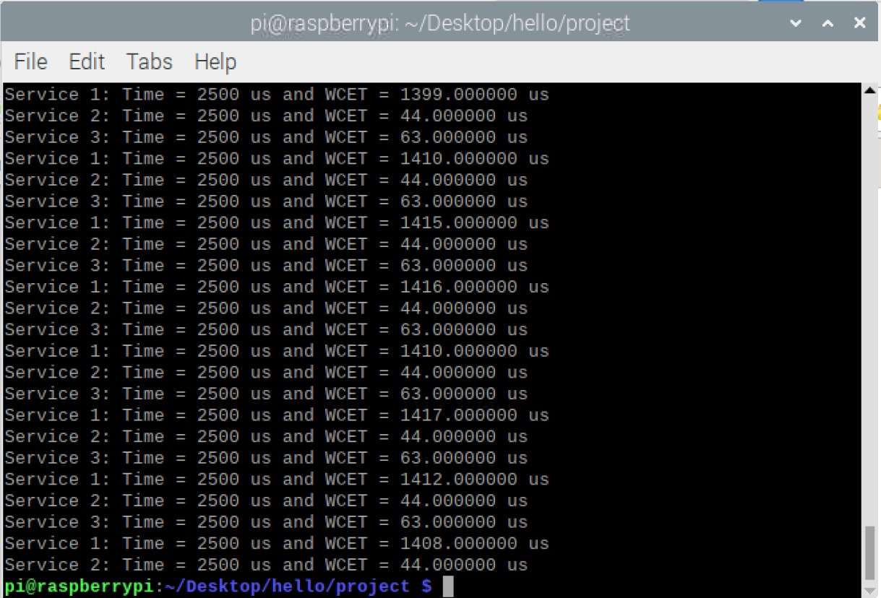
Timestamp of services

Slide 16
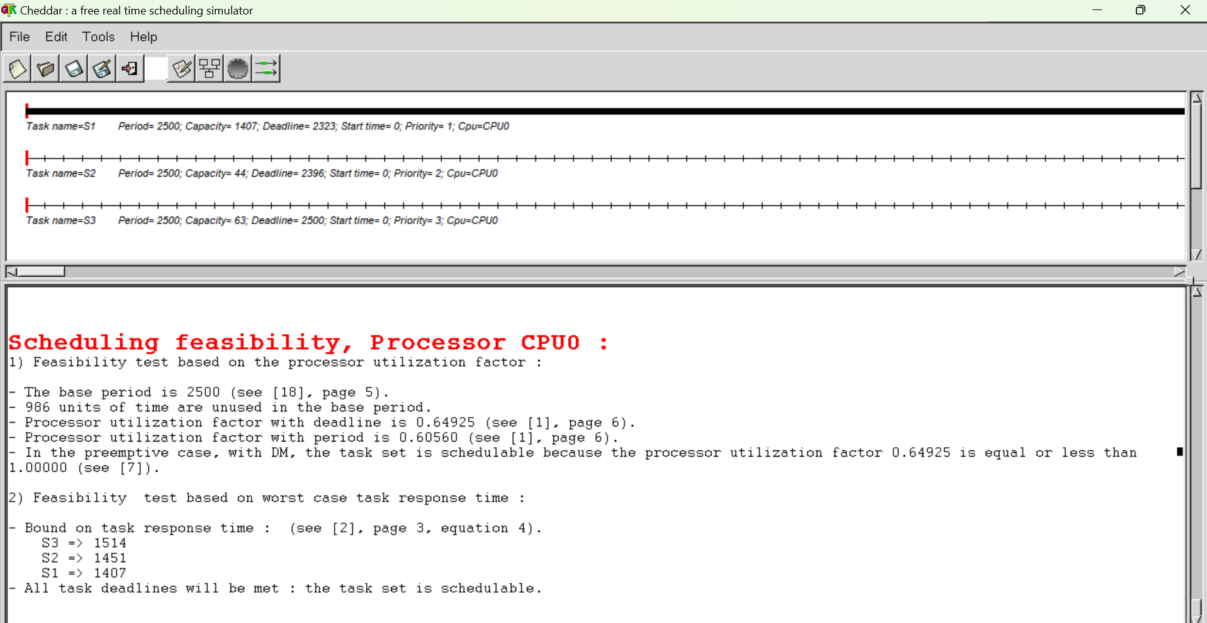
Cheddar analysis

Slide 17
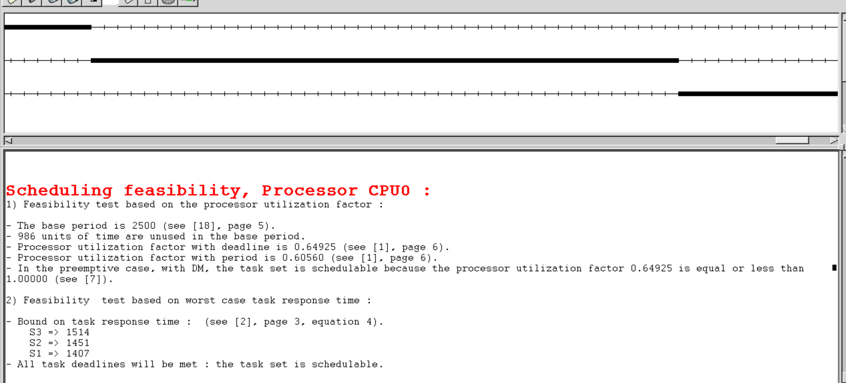
Cheddar analysis-2

Slide 18
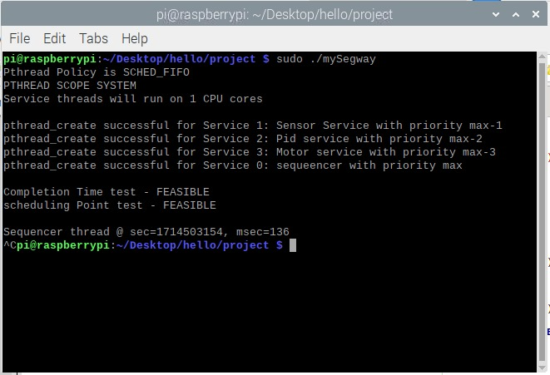
Scheduling point and Completion feasibility tests.

Slide 19
With a U of 60%, it passes RM LUB feasibility test for 3 services.
Deadlocks are prevented as no service is locking any resource.
We started with an aim to achieve a margin of 30% and ended up with almost 40%.

Slide 20
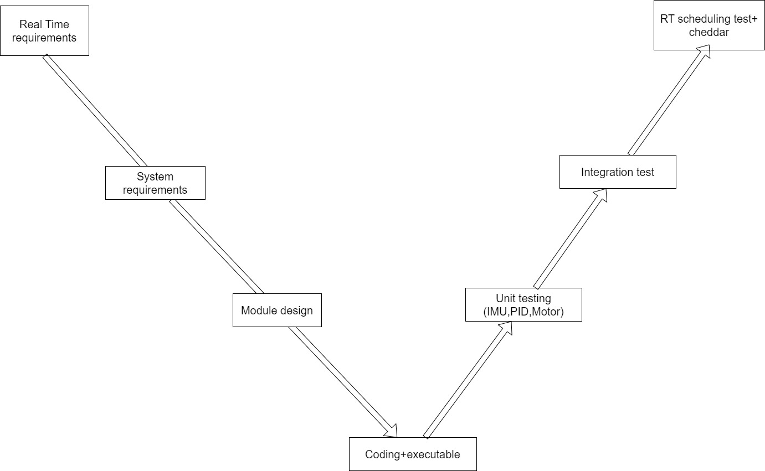
Verification and Validation

Slide 21
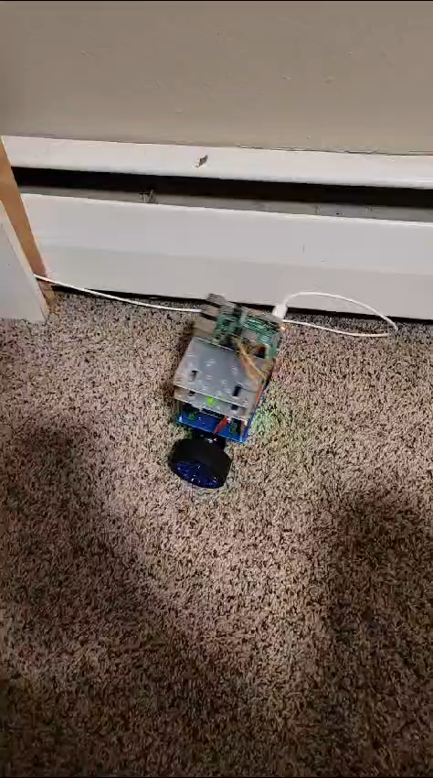
DEMO VIDEO The robot standing up forever is a control theory problem but the robot responding to events in time is a RT problem

Slide 22
THANK YOU
Any questions?
p.s. please vote for us

